Slide 1


EMPLOYEE DATA ANALYSIS USING EXCEL
STUDENT NAME: RAMYA SREE A
REG. NO.: 312209501
DEPARTMENT: B.COM BANK MANAGEMENT
COLLEGE: ANNA ADARSH COLLEGE FOR WOMEN

Slide 2
EMPLOYEE DATA ANALYSIS USING EXCEL

Slide 3
AGENDA
• PROBLEM STATEMENT • PROJECT OVERVIEW
• END USER
• OUR SOLUTION AND PROPOSITION
• DATASET DESCRIPTION
• MODELLING APPROACH
• RESULTS AND DISCUSSION
• CONCLUSION

Slide 4
PROBLEM STATEMENT
• Reviewing employee performance over time to guide strategic HR planning.
• Evaluating employee strengths, weaknesses, and trends to inform HR strategy.
• Analysing past performance to optimize future HR decisions.
• Assessing employee performance trends to drive strategic HR initiatives.
• Examining employee performance data to shape HR strategy and improvement.

Slide 5
PROJECT OVERVIEW
Developing a robust performance evaluation framework to accurately assess employee performance and inform data-driven decisions. This comprehensive approach will:
• Analyze job roles, goals, and KPIs.
• Combine quantitative and qualitative methods for a holistic view.
• Produce precise performance assessments and tailored development plans.
• Drive organizational efficiency and informed decision-making.

Slide 6
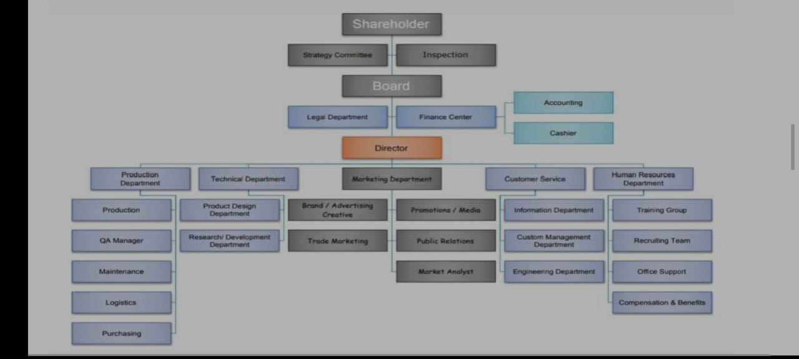
WHO ARE THE END USERS ?

Slide 7
Our solution and its value proposition
▪ Conditional formatting-missing.
▪ Filter-remove.
▪ Formula-performance.
▪ Pivot-summary.
▪ Graph-data visualization.

Slide 8
DATASET DESCRIPTION
• Employee dataset from Kaggle.
• 26-features.
• We selected 9-features.
Employee ID number
Employee name
Employee type
Performance level
Gender Employee rating number

Slide 9
THE “WOW” IN OUR SOLUTION
Using this formula we have measured the performance level of employees working in an organization.
Performance level = IF(Z2>=5,"VERY HIGH",Z2>=4,"HIGH",Z2>=3,"MED","TRUE","LOW“)

Slide 10
MODELLING
• Data collection
-Download the employee dataset from Kaggle.
-After the download, an Excel sheet will open.
-In that sheet, we have employee data details which have 26 features.
• Features collection
-We are selecting 9-features for our project.
-In that feature, we have employee ID, employee name, employee type, gender, performance level, and employee rating.
• Data cleaning
-In this method, we clear the empty rows or columns in the sheet.
-By selecting the empty rows and clearing them using a conditional formatting tool

Slide 11
• Performance level
-Here, we calculate the performance of the employees.
-By using a formula we can calculate the performance.
-Using IF formula: =IF(Z2>=5, "VERY HIGH", Z2>=4, "HIGH", Z2>=3, "MED", "TRUE", "LOW“)
• Pivot table
-After creating the performance level, click on the pivot table icon.
-In that, an application will appear as a row, column, fields. -Select the required items and click ok.
-Then using the details create a graph.
• Summary
-Using this method, we can know the performance level of the employees through the graph.

Slide 12
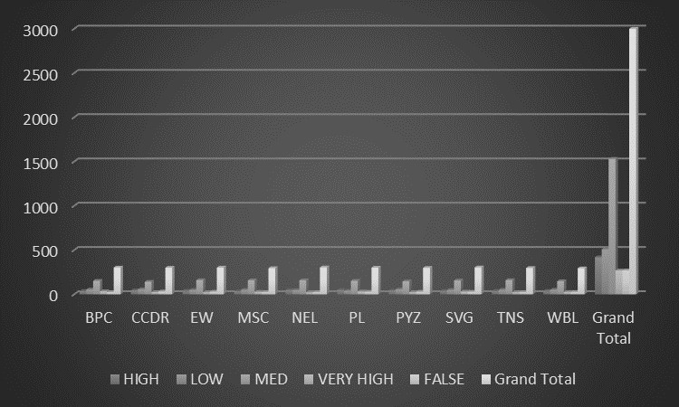
RESULTS Employee Performance Analysis

Slide 13
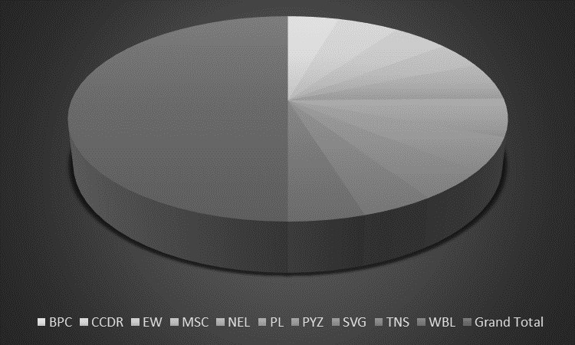
Performance Level

Slide 14
CONCLUSION
Effective employee performance analysis has far-reaching benefits, including better resource allocation, enhanced accountability, improved succession planning, increased employee retention, data-driven promotions, skills gap identification, enhanced employee experience, strategic alignment, competitive benchmarking, and continuous improvement. Accurate performance assessments enable targeted development initiatives, improved employee engagement, and a culture of constructive feedback, ultimately leading to a high-performing culture that supports the organization's overall mission and objectives.

